Slide 1
Day 1 HTML5 & CSS3

Slide 2
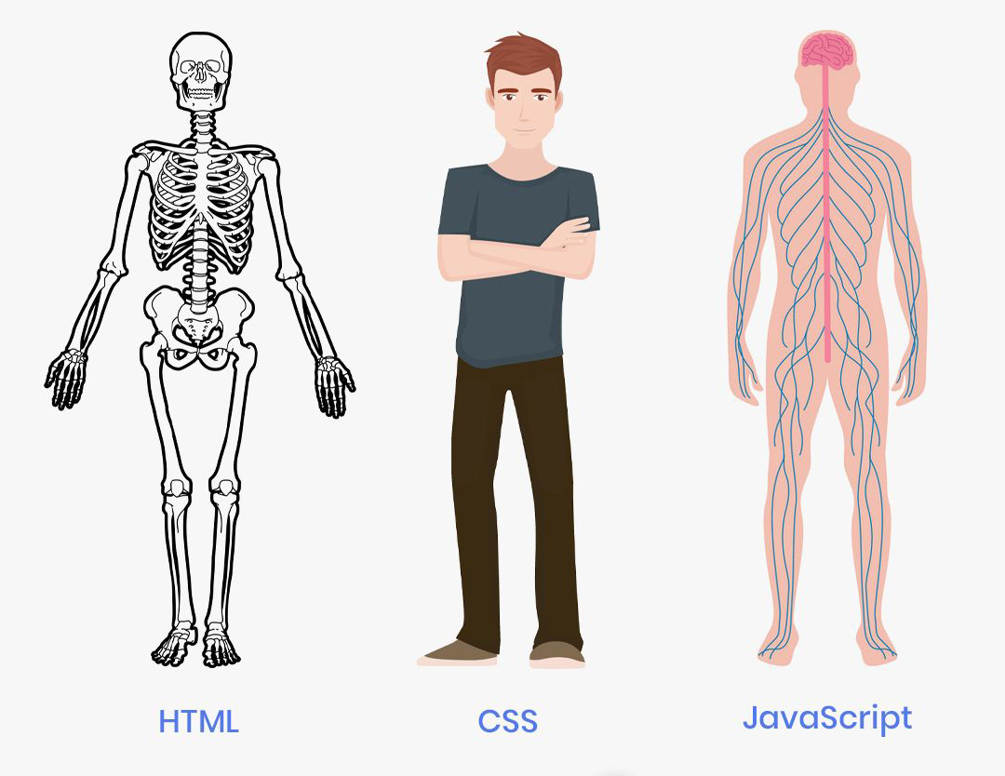
How it goes
As a web developer, the three main languages we use to build websites are HTML, CSS, and JavaScript. JavaScript is the programming language, we use HTML to structure the site, and we use CSS to design and layout the web page. At first we will be going through some concepts of html

Slide 3
Before we begin
This is for Beginners and Refresher for who already knows HTML and CSS
We will focus on HTML5 only
Slides and examples for the topic which we are covering

Slide 4
What is HTML?
01
HyperText Markup Language
02
NOT a programming language
03
Markup Language for creating web page and documents
04
Building blocks of the web

Slide 5
What we need to start
A Web Browser (Pick One) Eg:- Chrome, Firefox, Edge, Safari, IE (Never)
A text Editor (Pick one) Eg:- Sublime Text, Atom, Visual Studio Code, Brackets Preferably - Visual Studio Code and Chrome

Slide 6
Creating an HTML file
Does not need a server
Files must end with the .html extension
Runs in a Web browser (Chrome, Firefox, etc)
Index.html is the root / homepage of a website For Example:-
http://www.something.com (Loads the index.html file)
http://www.something.com/about.html (Loads the about.html file)

Slide 7
Tag Syntax
<tagname>Content<tagname>
Element name surrounded by angle brackets
<h1>About us </h1> <p>This is a paragraph</p>
Normally comes in pairs (start tag and end tag)
End tag is usually the same but with forward slash
<br/>(self closing) <br> (fine in HTML5)

Slide 8
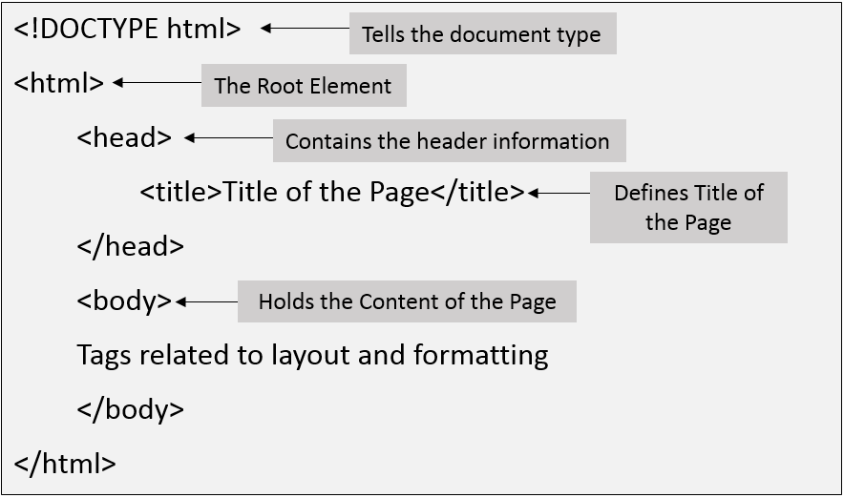
HTML Page Structure

Slide 9
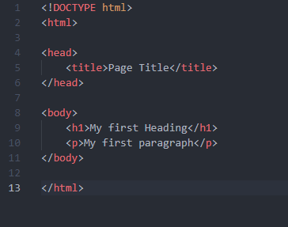
Page structure blocks

Slide 10
Doctype
Explains what type of document the page is
HTML4, HTML5, XHTML, etc
HTML5 <!DOCTYPE html>
HTML 4.01 Strict
<!DOCTYPE HTML PUBLIC "-//W3C//DTD HTML 4.01//EN" "http://www.w3.org/TR/html4/strict.dtd">
XHTML 1.0 Strict
<!DOCTYPE html PUBLIC "-//W3C//DTD XHTML 1.0 Transitional//EN" "http://www.w3.or/TR/xhtml1/DTD/xhtml1-transitional.dtd">

Slide 11
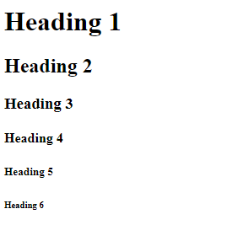
Heading Tags
<h1>Heading 1</h1>
<h2>Heading 2</h2>
<h3>Heading 3</h3>
<h4>Heading 4</h4>
<h5>Heading 5</h5>
<h6>Heading 6</h6>

Slide 12
Inline vs Block Level Elements
Inline Elements
Do not start on a new line
Takes only the necessary width
Block Elements
Start on a new line
Takes full width available
Inline Level: <span>, <img>, <a> Block Level: <div>, <h1> - <h6>, <p>, <form>

Slide 13
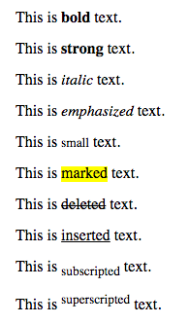
Formatting Tags
<b> - Bold text <strong> - Important text <i> - Italic text <em> - Emphasized text <mark> - Marked text <small> - Smaller text <del> - Deleted text <ins> - Inserted text <sub> - Subscript text <sup> - Superscript text

Slide 14
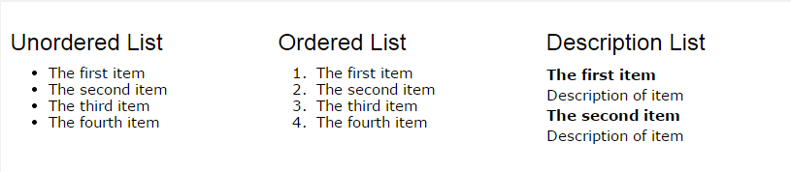
HTML Lists
Unordered List <ul>
<li>Coffee</li>
<li>Tea</li>
<li>Milk</li>
</ul>
Ordered List
<ol>
<li>Coffee</li>
<li>Tea</li>
<li>Milk</li>
</ol>
Description Lists
<dl>
<dt>Coffee</dt>
<dd>- black hot drink</dd>
<dt>Milk</dt>
<dd>- white cold drink</dd>
</dl>

Slide 15
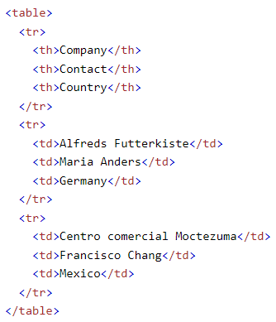
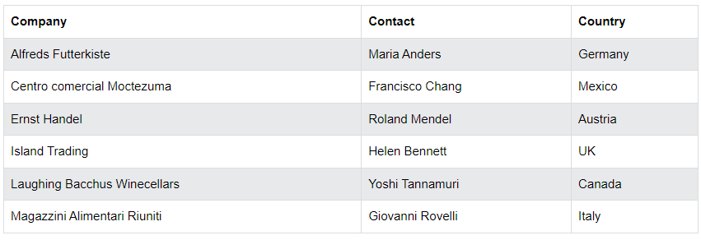
HTML Tables
HTML tables allow web developers to arrange data into rows and columns.

Slide 16
Tag Attributes
<tagname attributename=”attributevalue”>Content</tagname>
All tags can have attributes
Provide information about an element
Placed within the start tag
Key/value pairs (id=”someid”)
For Eg:- <h1 title=”company”>About Us</h1> <a href="https://www.google.com">Visit Google</a>

Slide 17
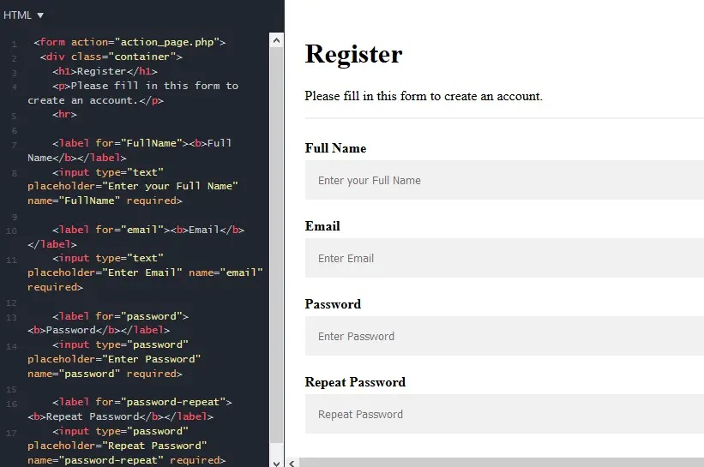
HTML Forms
An HTML form is used to collect user input. The user input is most often sent to a server for processing.

Slide 18
Input Tags
The <input> tag specifies an input field where the user can enter data. The <input> element is the most important form element.
<input type="button">
<input type="checkbox">
<input type="color">
<input type="date">
<input type="datetime-local">
<input type="email">
<input type="file">
<input type="hidden">
<input type="image">
<input type="month">
<input type="number">
<input type="password">
<input type="radio">
<input type="range">
<input type="reset">
<input type="search">
<input type="submit">
<input type="tel">
<input type="text">
<input type="time">
<input type="url">
<input type="week">

Slide 19
HTML Images
The HTML <img> tag is used to embed an image in a web page.
Images are not technically inserted into a web page; images are linked to web pages. The <img> tag creates a holding space for the referenced image.
The <img> tag is empty, it contains attributes only, and does not have a closing tag.
The <img> tag has two required attributes:
src - Specifies the path to the image
alt - Specifies an alternate text for the image

Slide 20
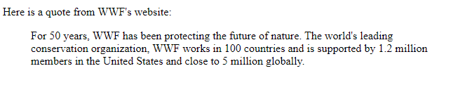
HTML Blockquote
The <blockquote> tag specifies a section that is quoted from another source.
Browsers usually indent <blockquote> elements (look at example below to see how to remove the indentation).
Eg:-
<blockquote cite="http://www.worldwildlife.org/who/index.html">
For 50 years, WWF has been protecting the future of nature. The world's leading conservation organization, WWF works in 100 countries and is supported by 1.2 million members in the United States and close to 5 million globally.
</blockquote>
The cite attribute specifies the source of a quotation.

Slide 21
HTML DIV
The <div> tag defines a division or a section in an HTML document.
The <div> tag is used as a container for HTML elements - which is then styled with CSS or manipulated with JavaScript.

Slide 22
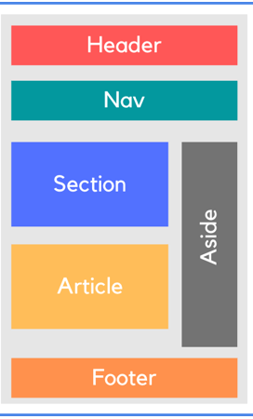
HTML Semantic Tags
A Semantic tag clearly describes it’s meaning to both the browser and the developer
<article>
<aside>
<details>
<figcaption>
<figure>
<footer>
<header>
<main>
<mark>
<nav>
<section>
<summary>
<time>

Slide 23
Webpage created only using HTML
A website created using only HTML structures and code blocks will look like this https://gilded-faun-22fde0.netlify.app/smashing.html
When the styles are added to a website it looks pretty much neat
https://verdant-cucurucho-504422.netlify.app/smashing.html
So next we will be looking into styling

Slide 24
What’s next…
So for now we have general idea of how HTML(Skeleton) works. But we need to know more about developing a user interface and experience. Post this we will be learning about styling with CSS3 and on how a user interface is developed

Slide 25
What is CSS?
Cascading style sheet
NOT a programming language
Stylesheet/Styling language
Used for website layout and design
Can be extended with Sass / Less

Slide 26
3 Methods for adding CSS
Inline - by using the style attribute inside HTML elements.
Internal - by using a <style> element in the <head> section.
External - by using a <link> element to link to an external CSS file.

Slide 27
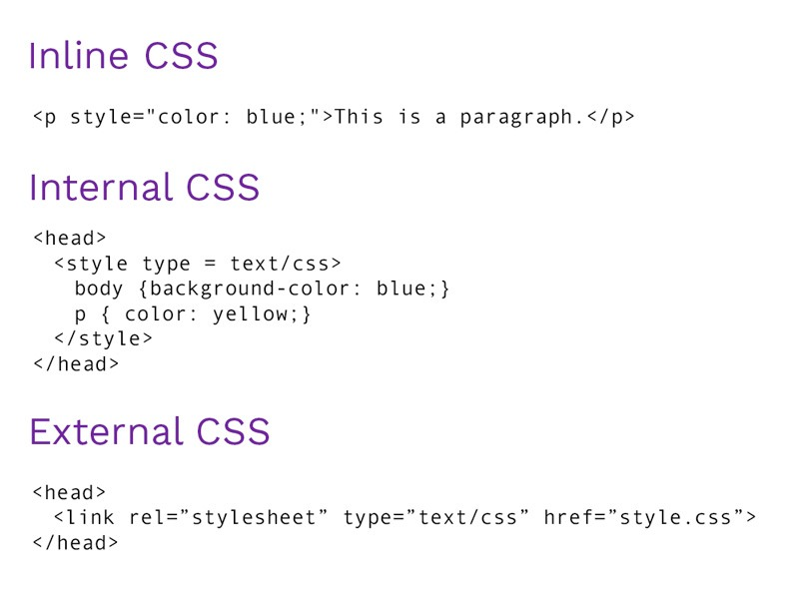
Examples of Inline, Internal and External styling

Slide 28
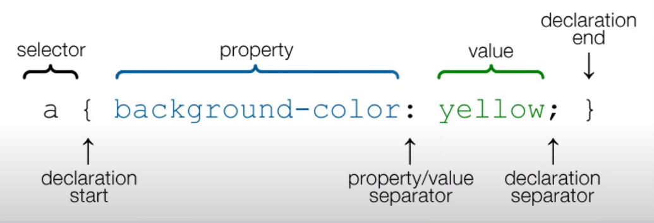
CSS Syntax

Slide 29
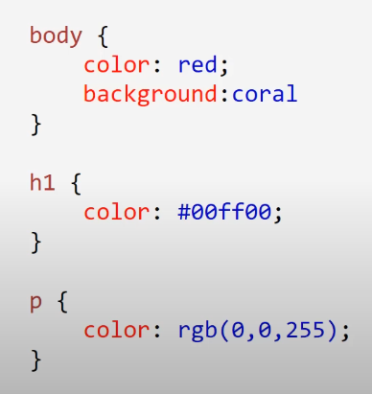
Colors in CSS
HTML5 color names
HexaDecimal
RGB

Slide 30
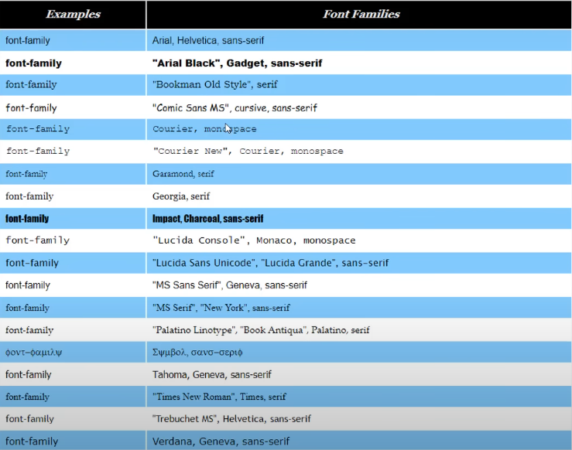
Web Safe Fonts

Slide 31
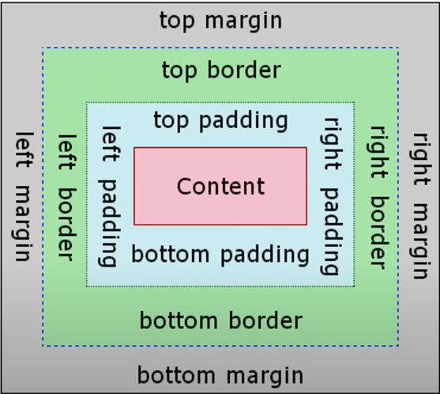
Box Model
In CSS, the term "box model" is used when talking about design and layout.
The CSS box model is essentially a box that wraps around every HTML element. It consists of: margins, borders, padding, and the actual content. The image below illustrates the box model:

Slide 32
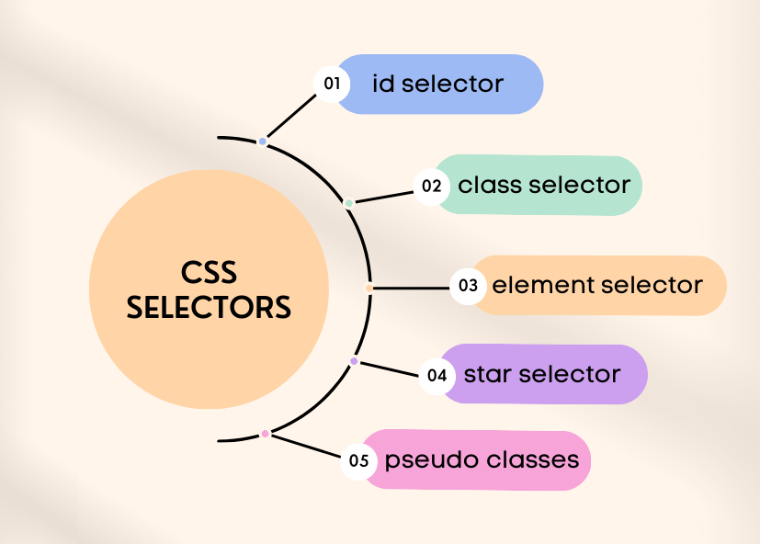
CSS Selectors
We can divide CSS selectors into five categories:
Simple selectors (select elements based on name, id, class)
Combinator selectors (select elements based on a specific relationship between them)
Pseudo-class selectors (select elements based on a certain state)
Pseudo-elements selectors (select and style a part of an element)
Attribute selectors (select elements based on an attribute or attribute value)

Slide 33
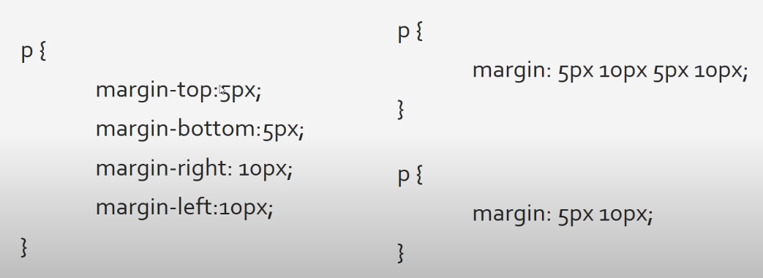
Margin & Padding Shorthand

Slide 34
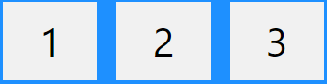
CSS Flexbox Layout Module
The Flexible Box Layout Module, makes it easier to design flexible responsive layout structure without using float or positioning. <div class="flex-container"> <div>1</div> <div>2</div> <div>3</div> </div> The example can be achieved using display flex

Slide 35
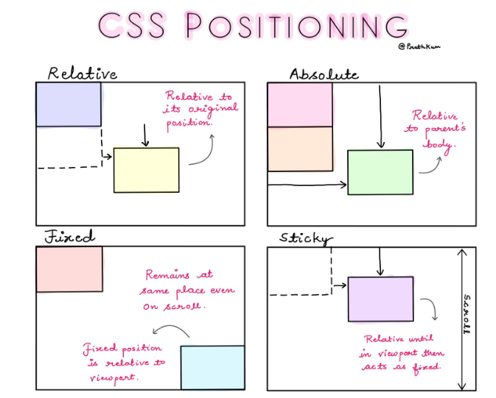
Positioning in CSS
Static
Relative
Absolute
Fixed
Initial
Inherit

Slide 36
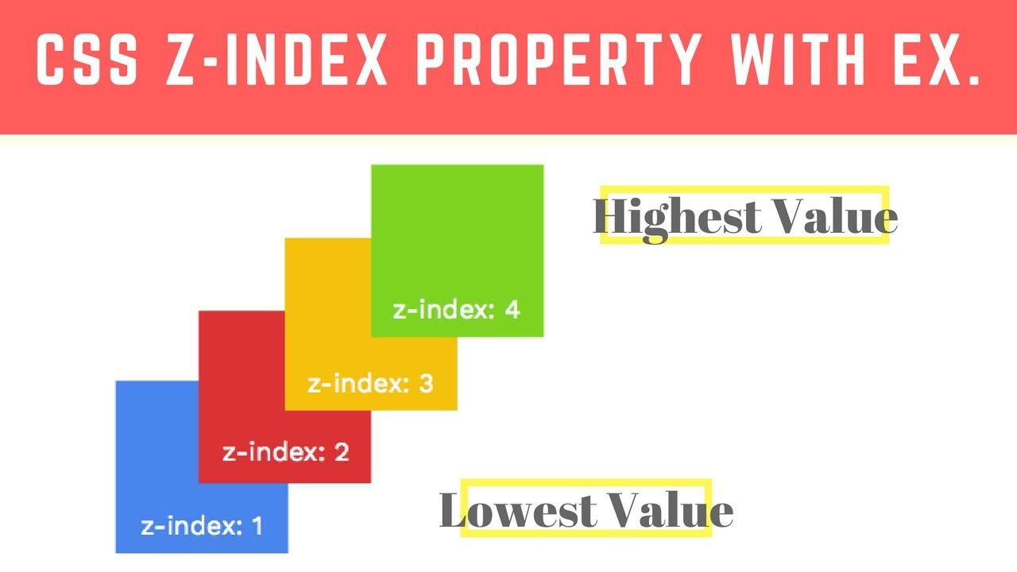
The z-index Property
When elements are positioned, they can overlap other elements.
The z-index property specifies the stack order of an element (which element should be placed in front of, or behind, the others).
An element can have a positive or negative stack order:

Slide 37
What’s Next
There are lot of CSS properties which are used based on designing scenario. So what we have discussed now is the commonly used properties. Now we can build a own website using these.

Slide 38

Thank you!
Post this we will be learning how to do functionalities using Javascript.

